Slide 1
Building Simple Serverless Applications with AWS Lambda
<Ronald RC>

Slide 2
Agenda
AWS Lambda
AWS API Gateway
The Serverless Framework
Creating Serverless Framework
Programming a Lambda Function with Node.js
Developemt, Testing and Debuging Lambda Functions
Building a Stateless Serverless Web Application Backend
Stateful Serverless Backend with Dynamo DB

Slide 3
AWS Lambda
The AWS Lambda web dashboard
Lambda functions blueprints
Lambda function configuration and deployment
Lambda function testing

Slide 4
AWS API Gateway
The AWS API Gateway web dashboard
Creating new REST API
Connecting our API to our lambda function
API testing

Slide 5
The Serverless Framework
Create REST API
Create Lambda Function and connect it to our API
Deploy and test Lambda Functions using serverless command-line interface (CLI)
Local function invocation
Remote function invocation

Slide 6
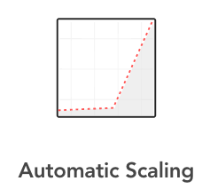
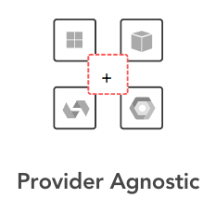
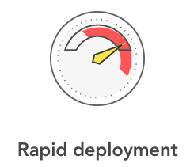
Background
… Serverless computing as a new and efficient software development approach that abstracts infrastructure from the functionality itself …
Cagatay Gurturk (Building Serverless Architectures)
Notes:
Serverless es un nuevo y eficiente enfoque de desarrollo de software que abstrae la infraestructura de la funcionalidad
Desarrollar, probar e implementar en un único entorno, en cualquier proveedor de la nube.
No tiene que aprovisionar infraestructura ni preocuparse por la escala.

Slide 7
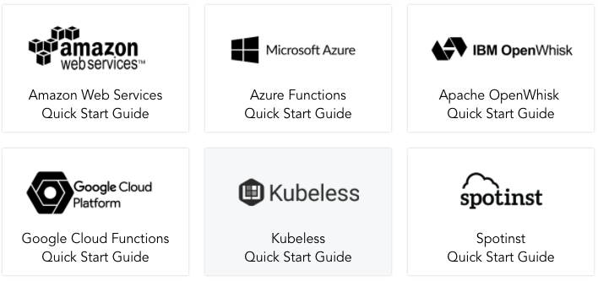
Cloud Providers

Slide 8

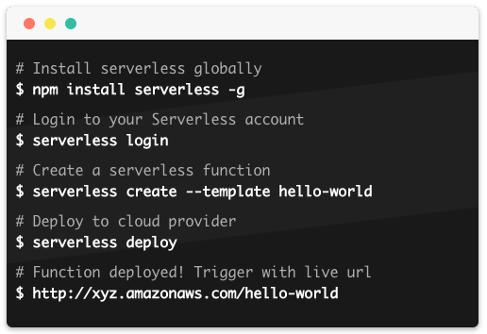

Serverless Framework
Notes:
Install the serverless framework
npm install -g serverless
The Serverless Framework is a CLI tool that allows users to build & deploy auto-scaling, pay-per-execution, event-driven functions.
Write your code, configure events to trigger your functions, then deploy & run those functions to your cloud provider via the Serverless CLI.

Slide 9
Creating Serverless Project
Create basic REST API
Create a simple Node.js lambda function

Slide 10
Programming a Lambda Function Node.js
The Lambda function handler and its arguments:
The event object
The context object
The callback object

Slide 11
Testing and Debugging Lambda functions
Three different testing and debugging approaches
Using Serverless framework
Using Postman
Using the AWS Management Console

Slide 12
Reference list
Cagatay Gurturk (2017) Building Serverless Architectures
Peter Sbarski (2017) Serverless Architectures on AWS

Slide 13
Demo

Slide 14
Architecture

Slide 15
npm install -g serverless
sls create -t aws-nodejs -n eva0-services-loan-app
sls deploy -f hello
sls invoke -f hello
sls invoke local -f hello
sls invoke -f evaluate -p event.json
sls invoke local -f evaluate -p event.json
npm init -y
npm install --save aws-sdk
npm install --save uuid

